Slide 1

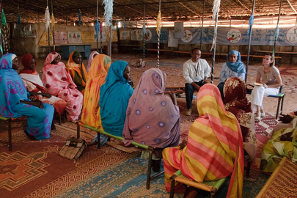
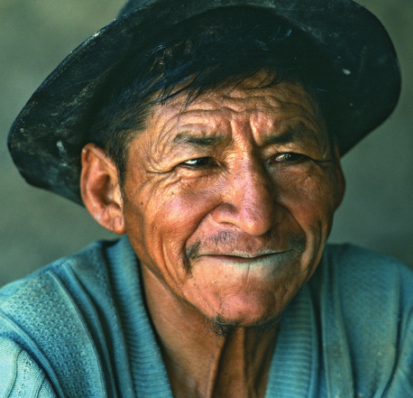
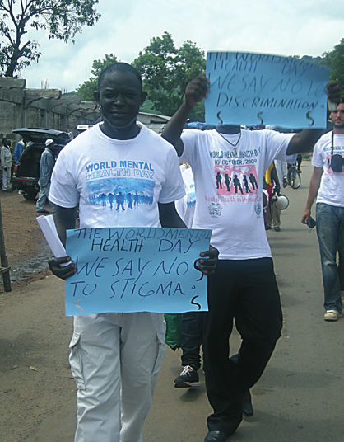

WHO QualityRights
Transforming services & promoting rights in mental health
Dr Michelle Funk
Head, Policy, Law and Human Rights (PLR)
Department of Mental Health & Substance Use,
World Health Organization

Slide 2

Urgent need for person-centred &
human rights approach in mental health
Rights based law reform
Pressing issues to address:
Institutionalisation
Use of coercive practices, violence, abuse and neglect
Denial of peoples’ legal capacity and right to decide over their own treatment and other key elements of their lives
Disempowerment that many people experience within the mental health system
Over emphasis on the diagnosis and use of medication to manage symptoms rather than taking a holistic person-centred rights-based approach to treatment and care
Notes:
2

Slide 3
Key CRPD rights relevant to mental health?
Legal capacity and supported decision making (Art 12)
Liberty and Security of person (Art 14)
Independent community living (Art 19)
Right to health (Art 25)

Slide 4
WHO QualityRights objectives
Rights based law reform
Build capacity to combat stigma and discrimination and promote human rights and recovery
Create community-based services and supports that respect and promote human rights
Promote the participation of persons with lived experience and support civil society
Reform national policies and legislation in line with the CRPD and other international human rights standards
Notes:
4

Slide 5
Capacity building on human rights
in mental health
Attitude and mindset change is fundamental for rights based mental health reform
Shifts in attitudes to:
  combat stigma and discrimination
  ensure people are seen as rights holders (respect for legal capacity; freedom from coercion etc.)
Without significant mindset change the risk is that mental health reform efforts will only lead to a slight improvement in practices without any fundamental change in the paradigm

Slide 6
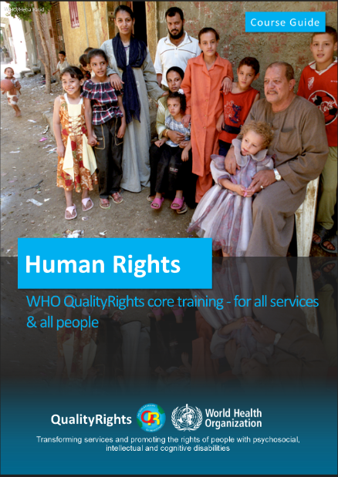
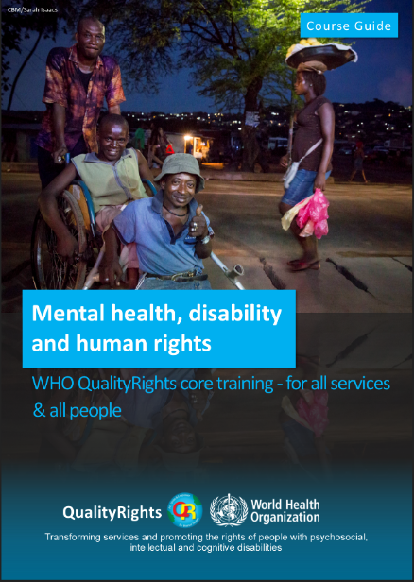
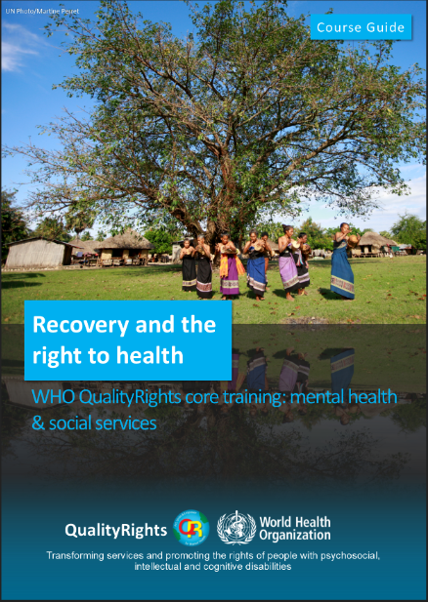


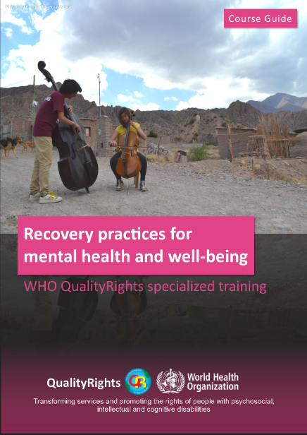
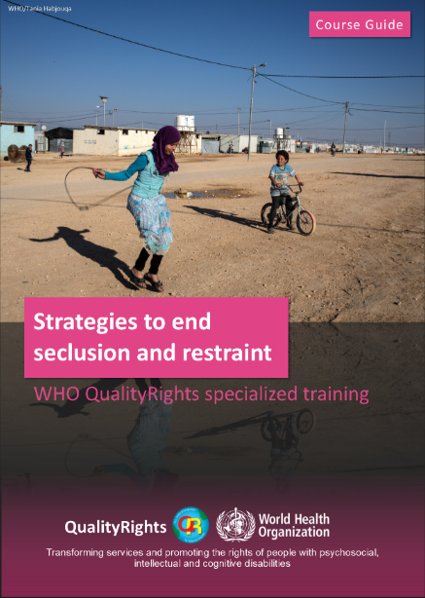
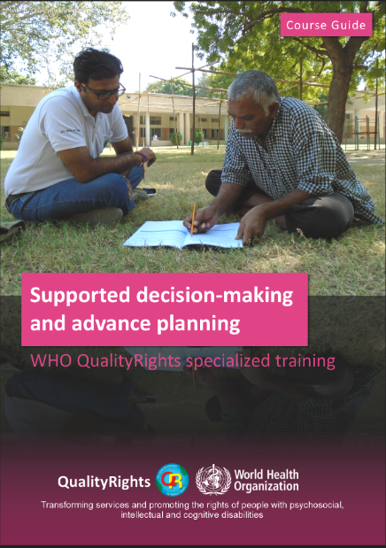
Capacity building on human rights
in mental health
QualityRights face-to-face training modules
Core modules
Specialized modules

Slide 7


Capacity building on human rights
in mental health
QualityRights e-training
Mental Health, recovery and community inclusion
Changing mindsets of whole communities, on massive scale
Free of cost and open to all
Available in 11 languages including English, Spanish and French
WHO certificate upon completion
Target:
5 million learners to complete the e-training by 2025

Slide 8
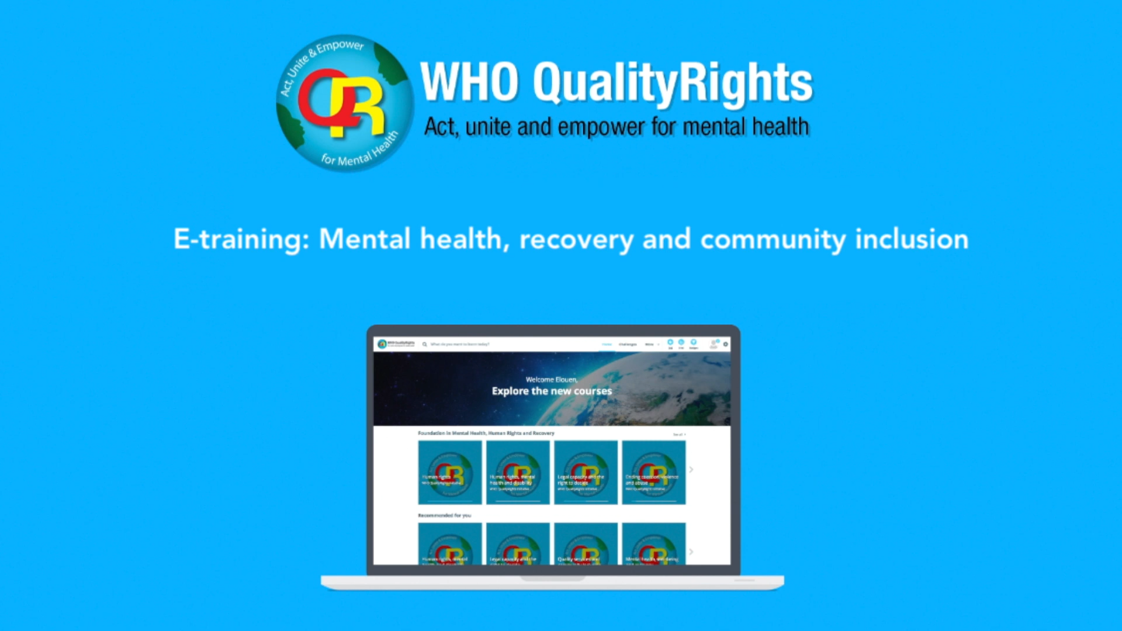
QualityRights e-training overview
Rights based law reform
Notes:
8

Slide 9
QualityRights e-training evaluation:
Pre and post training attitudinal scores
  17 attitudinal items → highly significant changes on all items (p<0.0001)
  38% improvement in overall attitudes
  50% improvements on many challenging issues:
    Legal capacity & the right to decide
    Ending coercive practices
    Choice and information about treatment
    Right to community inclusion

Slide 10
QualityRights e-training
Quotes from learners
“Los Derechos Humanos, son una lucha en la cual todos debemos participar y es una enseñanza que en principio debe partir del hogar y solidificarse en la sociedad, en cada institución estatal o privada existente y ser conocida y adoptada por todos como principio fundamental y darle el valor que amerita, Hoy por hoy evidenciamos que estamos muy lejos de que la DUDH se adopte en todas las naciones y se cumpla a cabalidad por Derecho. Excelente Curso. Gracias.”
“Muchas gracias por esta intruducción. Me permitió reflexionar respecto a mi práctica profesional y lo que enseño a mis estudiantes.”
“Wow. Learning has indeed taken place. I pray to resolve from making the final and only decision for my patients without caring for their legal capacity.”
“Life changing!”
“I loved every bit of it! So interesting and captivating. Very short and straight to the point. And, very educative! I am glad I chose to do it.”
“Coercion, violence and abuse at work must end NOW!!!”

Slide 11
QualityRights e-training reach
QR e-training stats
90,760 people have registered on the e-training platform
49,526 have started the e-training course
38,187 have completed the course & been awarded WHO certificate

Slide 12
Impact of WHO’s QualityRights e-training
  5 million people successfully trained by 2024
  Eliminating stigma and discrimination
  Promoting a new mindset → approach in mental health based on support, hope, acceptance and inclusion
1 person trained
Positively impacting the lives of 100 people experiencing mental health challenges
5 million people trained
Improving the lives of 500 million people experiencing mental health challenges

Slide 13
Benefits for stakeholders
Capacity building on human rights
in mental health
  Health and social care providers
  Policy makers
  OPD’s, NGOS and other community organizations
  Families, carers, supporters,
  and others
  People with lived experience
  Better treatment, care and support
  Policies that better respond to peoples’ needs, dignity and rights
  Support mental health of marginalized individuals and groups
  Support people in distress in a way that respects dignity and autonomy
  Learn about rights, pathways to recovery and contribute to policy

Slide 14
Creating rights-based community
mental health services
Community based services based on the social and human rights models of disability
Holistic services that consider people in the context of their whole lives & address social determinants of mental health
Access to the full range of services & supports necessary to promote community inclusion and prevent isolation & segregation
Services free from coercion & that promote legal capacity

Slide 15
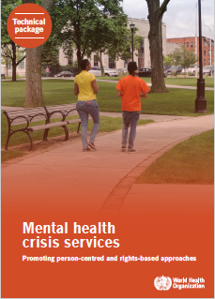

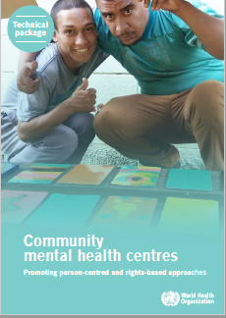


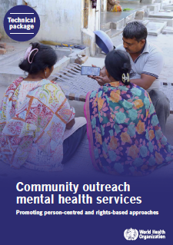

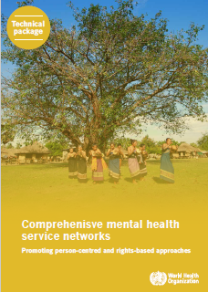
WHO Guidance on community mental health
services: Promoting person-centred &
rights-based approaches
Notes:
15

Slide 16
Afiya House, USA
Link House,
UK
Open Dialogue, Finland
Tupu Ake, NZ
BET Unit, Blakstad Hospital, Norway
Kliniken Landkreis Heidenheim, Germany
Soteria Berne, Switzerland
CAPS III – Brasilândia, Brazil
Aung Clinic, Myanmar
Phoenix Clubhouse, China, Hong Kong SAR
Hearing Voices support groups
Nairobi Mind Empowerment Peer Support Group, Kenya
Peer Support South East Ontario, Canada
Atmiyata, India
Friendship Bench, Zimbabwe
Home Focus, Ireland
Naya Daur, India
Personal Ombudsman, Sweden
Hand in Hand supported living, Georgia
Home Again, India
KeyRing Living Support Networks
Shared Lives, UK
Mental health networks:
Campinas, Brazil
East Lille, France
Trieste, Italy
Peru
Bosnia & Herzegovina
Lebanon

Slide 17
WHO Guidance on community mental health
Services: Common factors for good practice services
Rights based law reform
Each selected service has embraced the paradigm shift from a biomedical model focused on symptom reduction to a rights-based approach
Services were selected according to human rights criteria relevant for mental health
  Respect people’s legal capacity - choice & decisions in treatment, care & support
  Use of strategies to end coercion – seclusion, restraint, physical, sexual & emotional abuse
  Actively involve and include people in their own care & in running of services
  Link people to relevant community services and supports - social protection and disability benefits, housing, employment opportunities etc
  Provide person-centered holistic care addressing relationships, work, family, and education – not just diagnosis, medication and symptom reduction
Each service had evaluation data demonstrating acceptability & effectiveness
Notes:
17

Slide 18
WHO Guidance on rights-based
community mental health services
Recommendations
Increasing funding to develop/scale up rights- based services
Establishing legal and policy frameworks that are comprehensive, holistic and align with human rights standards and that reflect the collaboration of all sectors
Establishing a comprehensive rights-based network of community mental health services that interface with a strong social sector
Widescale capacity building on mental health, human rights and disability for all stakeholder groups
Integrating training on rights, disability and person centred, recovery-oriented approaches in undergraduate and graduate course curricula
Collecting data on health and social outcomes for mental health services
Increasing funding for research on services using a rights-based approach
Engaging organizations of people with psychosocial disabilities as advisors on policy, planning, law, service development and training

Slide 19

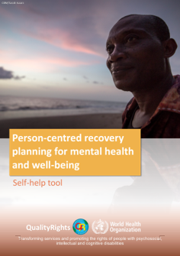
Person-centred recovery planning for
mental health and well-being:
A self-help tool
  Explore meaning of recovery
  Develop a plan for pursuing dreams and goals
  Create personal wellness plan
  Planning for difficult times – response during and after a crisis

Slide 20


Assessing & transforming services
Assessing & transforming services
  QualityRights Assessment toolkit
  Guidance - Transforming services & promoting rights

Slide 21
Promote the participation of persons
with lived experience &
support civil society
  Expertise of persons with lived experience (PLE) crucial for reform
  BUT PLE not invited to:
    guide policy and law development
    co-develop and implement services, training, and research
  WHO QualityRights actions for meaningful participation.
    Creating opportunities to influence policy & legislative processes
    Building capacities of PLE and OPDs to become experts on rights-based reform
    Capitalising on the skills of PLE to rollout QualityRights
    Engaging PLE in the development of WHO normative guidance
Notes:
21

Slide 22
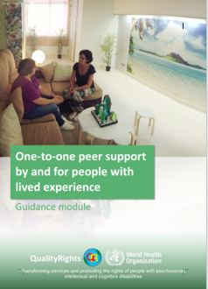
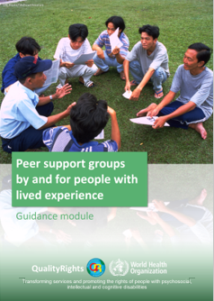

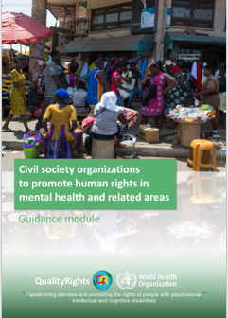
Engaging with persons with
lived experience & civil society
  Providing (i) one-to-one peer support and (ii) peer support groups
  (i) Setting-up and operating civil society organizations and (ii) putting in place advocacy campaigns

Slide 23
Mental Health Policy Reform
Human-rights aligned GUIDANCE on:
Social and structural determinants of health
Climate change
Racism and colonialism
Discrimination based on gender, sexual orientation, age, or disability;
Education, housing, employment, or social protection
Violence, abuse, and crime
COVID-19 and other health emergencies
mental health service and system related issues.
    National mental health policies & action plans (2023)
Notes:
23

Slide 24
Policy package toolkit – 3 inter-related components
2
Key policy directives and strategic actions for other sectors
Health
Disability
Education
Employment
Housing
Social protection
Financing
Culture and sports
Criminal Justice
Agriculture
Urban design;Transport
Gender and human rights
1
Key policy directives & strategic actions for mental health sector
Policy directives
Strategies
Actions
3
Process steps for developing, implementing & evaluating policy & strategic action plans
Notes:
24

Slide 25
POLICY AREAS FOR ACTION
1. Service organisation and development
2. Human resource and workforce development
3 Assessment, interventions & support
4. Mental health sector contributions to addressing structural & social determinants & society wide issues impacting mental health and well-being
1.1. Coordinated rights-based community mental health & primary care services & supports
2.1. Human resource development including role & task sharing
3.1. Assessment of mental health and support needs
4.1. Transforming mindsets, improving literacy to promote mental health & combat stigma, discrimination & exclusion of persons wth mh conditions and all marginalized groups
1.2. Partnerships for community inclusion, socioeconomic empowerment, & protection & promotion of rights
2.2. Recruitment and retention of staff
3.2. Non-pharmacological interventions, ( lifestyle, psychological, social, economic
Policy Directives
4.2. Joint sector action on structural determinants & society wide issues
2.3. Competency based curricula for mental health
4.3 Mental health & psychosocial support in humanitarian emergencies
1.3. Deinstitutionalisation
3.3. Psychotropic drug interventions
4.4 Suicide prevention
5. Governance, accountability & other enablers
5.1.Leadership and accountability
5.2. Finance and budget
5.3. Persons with lived experience, civil society, people and community
5.4 Rights-based legislation related to mental health
Policy Directives
Emphasis throughout
Human rights, person centered and recovery approach
Meaningful participation of persons with lived experience, stigma, discrimination, changing attitudes, mindsets & culture in mh
Key considerations throughout:
age; gender; sexual orientation; disability; immigration & refugee status; race & ethnicity, amongst others

Slide 26
Rights-based Law Reform
Human-rights aligned GUIDANCE on:
  Access to quality mental health care
  Community-based mental health services
  Non-discrimination
  Legal capacity and supported decision-making
  Eliminating coercive practices in mental health care
  Independent living and community inclusion
  Criminal law and justice
  Participation
  Accountability
    Mental health related legislation (2023)
Notes:
26

Slide 27
WHO QualityRights resources & links
  Capacity building
  QR training & guidance materials: https://www.who.int/publications/i/item/who-qualityrights-guidance-and-training-tools
  QR e-training on mental health, recovery & inclusion:
  https://www.who.int/teams/mental-health-and-substance-use/policy-law-rights/qr-e-training
  Creating rights-based community services
  Guidance & technical packages on community mental health services:
  https://www.who.int/publications/i/item/guidance-and-technical-packages-on-community-mental-health-services
  QR service assessment toolkit:
  https://www.who.int/publications/i/item/9789241548410
  QR module on transforming services & promoting rights:
  https://www.who.int/publications/i/item/9789241516815
  Participation
WHO Guidance on one-to-one peer support
https://apps.who.int/iris/bitstream/handle/10665/329591/9789241516785-eng.pdf
WHO Guidance on peer support groups
https://apps.who.int/iris/bitstream/handle/10665/329594/9789241516778-eng.pdf
WHO Guidance setting-up civil society organizations
https://apps.who.int/iris/bitstream/handle/10665/329589/9789241516808-eng.pdf
WHO Guidance on advocacy campaigns
https://apps.who.int/iris/bitstream/handle/10665/329587/9789241516792-eng.pdf
  Policy and law reform
WHO/OHCHR Guidance on mental health, human rights & law – coming soon
WHO Guidance on mental health polices & strategic action plans - coming soon
WHO MiNDbank online database:
https://extranet.who.int/mindbank/
QualityRights country implementation portal: https://qualityrights.org/

Slide 28
THANK YOU!

